Slide 1
HTTP Communication
Advanced HTTP Requests and Error Handling
Lecture 2
By James(Jin) Wang
12/25/2021

Slide 2
Outline
Consuming REST services
Retrieving data with resolvers
Creating interceptors
Caching data in your apps
Unit testing

Slide 3
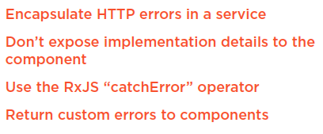
Retrieving data with resolvers
  Handling HTTP Errors
  Demo: handling HTTP errors

Slide 4
Summary

Slide 5
Assignment

Slide 6
Self Study
  Angular HTTP Communication
  https://app.pluralsight.com/library/courses/angular-http-communication

